Slide 1
Welcome
Senior Financial Aid Night

Slide 2
Applying to Colleges
Apply as soon as possible
It's ok to apply to more than one college.
Many colleges have a December 1st application deadline to be considered for scholarships offered from that specific college.
ACT scores- you will not have another chance to take the ACT before this deadline.
Transcripts are needed to apply to colleges. You can find a transcript request form on the USD105 website under "Counselor's Corner. Fill it out and email or give to Marcy or Melissa in the office. They will send it directly to the college you are applying to.

Slide 3
FAFSA
Fill this out ASAP-Some say that monies are sometimes distributed on a first come first serve basis.
The earlier you fill this out the better! Challenge yourself to get it done before Thanksgiving.

Slide 4
HANDOUTS:
TYPES OF STUDENT AID
7 THINGS YOU'LL NEED BEFORE YOU FILL OUT THE FAFSA
8 STEPS TO FILLING OUT THE FAFSA
3 FAFSA DEADLINES YOU MUST KNOW
11 COMMON FAFSA MISTAKES
5 THINGS TO DO AFTER FILING YOUR FAFSA FORM
5 THINGS TO KNOW WHEN EVALUATING A FINACIAL AID OFFER

Slide 5
TYPES OF STUDENT aID

Slide 6
For undergraduates with financial need who have not earned bachelor’s or professional degrees. For details and updates, visit StudentAid.gov/pell-grant.
Amounts can change annually. For the 2020–21 award year, the award amount is up to $6,345.
FEDERAL PELL GRANT

Slide 7
Federal Work-Study
For undergraduate and graduate students;
Part-time jobs can be on campus or off campus. Money is earned while attending school.
Your total work-study award depends on when you apply, your level or financial need, and your school’s funding level. For details and updates, visit StudentAid.gov/workstudy.
No annual minimum or maximum amounts

Slide 8
Direct Subsidized Loan
For undergraduate students who have financial need;
U.S. Department of Education generally pays interest while the student is in school and during certain other periods; a student must be enrolled at least half-time.
Interest rates for new Direct Subsidized Loans can change every year.
Loans made to undergraduate students during the 2020–21 award year have a fixed interest rate of at 2.75% for the life of the loan. For details and updates, visit StudentAid.gov/sub-unsub
Up to $5,500 depending on grade level.

Slide 9
Direct Unsubsidzed Loan
For undergraduate and graduate or professional students
The borrower is responsible for interest during all periods
a student must be enrolled at least half- time
financial need is not required
Interest rates for new Direct Unsubsidized Loans can change every year
Loans made to undergraduate students during the 2020–21 award year have a fixed interest rate of 2.75% for the life of the loan
For details and updates, visit StudentAid.gov/sub-unsub
Up to $20,500 (less any subsidized amounts received for same period), depending on grade level and dependency status.

Slide 10
Direct PLUS Loan
For parents of dependent undergraduate students and for graduate or professional students;
The borrower is responsible for interest during all periods; a student must be enrolled at least half-time; financial need is not required; the borrower must not have an adverse credit history.
Interest rates for new Direct PLUS Loans can change every year.
Loans made during the 2020–21 award year have a fixed interest rate of at 5.30% for the life of the loan. For details and updates, visit StudentAid.gov/plus.
Maximum amount is the cost of attendance minus any other financial aid received.

Slide 11
7 THINGS YOU NEED BEFORE FILLING OUT THE FAFSA
Your FAFSA ID
Your Social Security Number
Your Driver's License Number
Your 2019 Tax records
Records of your untaxed income
Records of your assets (money)
List of the school(s) you are interested in attending

Slide 12
8 STEPS TO FILLING OUT THE FAFSA FORM
Create
Create an account
Start
Start the FAFSA form at fafsa.gov (http://fafsa.ed.gov)
Fill out
Fill out the Student Demographics section
List
List the schools to which you want your FAFSA infromation sent
Answer
Answer the dependency status questions
Fill out
Fill out the Parent Demographic section
Supply
Supply your financial information

Slide 13
11 COMMON FAFSA MISTAKES
Not Completing the FAFSA Form
Not Filling Out the FAFSA Form as Soon as It's Available
Not Filing the FAFSA Form by the Deadline
Not Getting an FSA ID Before Filling Out the FAFSA Form
Not Using Your FSA ID to Start the FAFSA Form
Not Using the IRS Data Retrieval Tool (IRS DRT)
Not Reading Definitions Carefully
Inputting Incorrect Information
Not Reporting Required Information
Listing only one college
Not signing the FAFSA form

Slide 14
5 Things to do After Filing Your FAFSA Form
Review Your FAFSA Confirmation Page
1
Review Your Expected Family Contribution (EFC)
2
Apply for as Many Scholarships as You Can
3
Be on the Lookout for Your Aid Offer(s)
4
Make FAFSA Corrections if You Need To
5

Slide 15
Scholarships!!

Slide 16
Types of Scholarships:
LOCAL
THES ARE LISTED ON THE USD105 WEBSITE UNDER COUNSELOR'S CORNER. THE LIST WILL BE UPDATED BY THE FIRST OF THE YEAR
COLLEGE
MANY COLLEGES GIVE SCHOLARSHIPS TO STUDENTS BASED ON ACADEMIC PERFORMANCE, FAMILY SITUATIONS, FAMILY ALUMNI STATUS WITH SCHOOL, ETC...
BOARD OF REGENTS
THE KANSAS BOARD OF REGENTS OFFER SCHOLARSHIPS IN SEVERAL AREAS
TUTION ASSISTANCE VIA A JOB
SOME EMPLOYERS HELP BY PAYING PARTIAL TUITION OR BY DONATING MONEY TO CURRENT EMPLOYEES WANTING TO GO BACK TO SCHOOL.

Slide 17
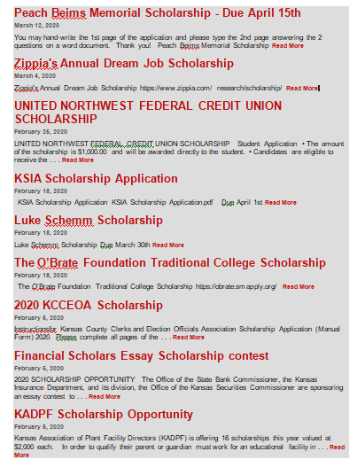
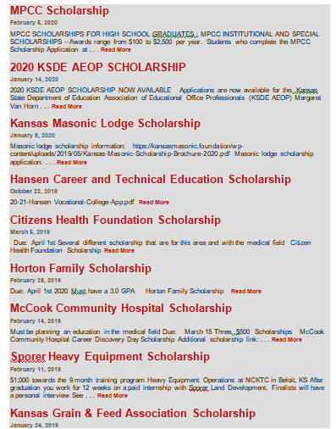

Slide 18
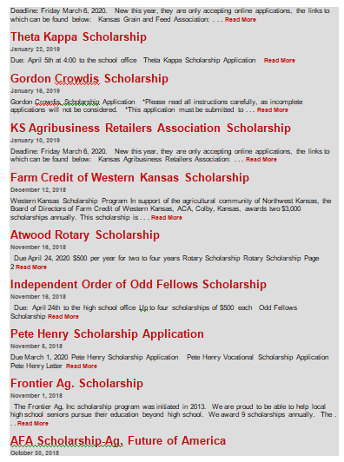
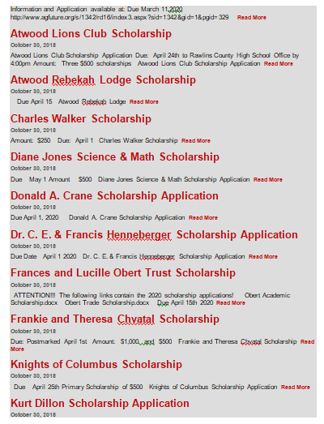

Slide 19
